Slide 1
Project 1 presentation.

Slide 2
What is my project about?
I am comparing the local weather to the local market share volume of the stock exchange.

Slide 3
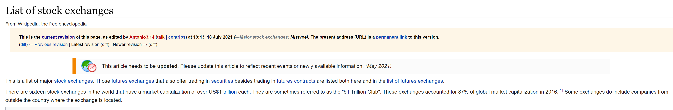
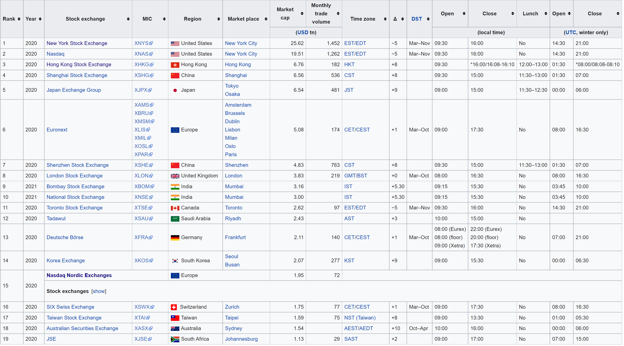

Slide 4
But how do we see what the highest stock exchanges are for any period of time?

Slide 5
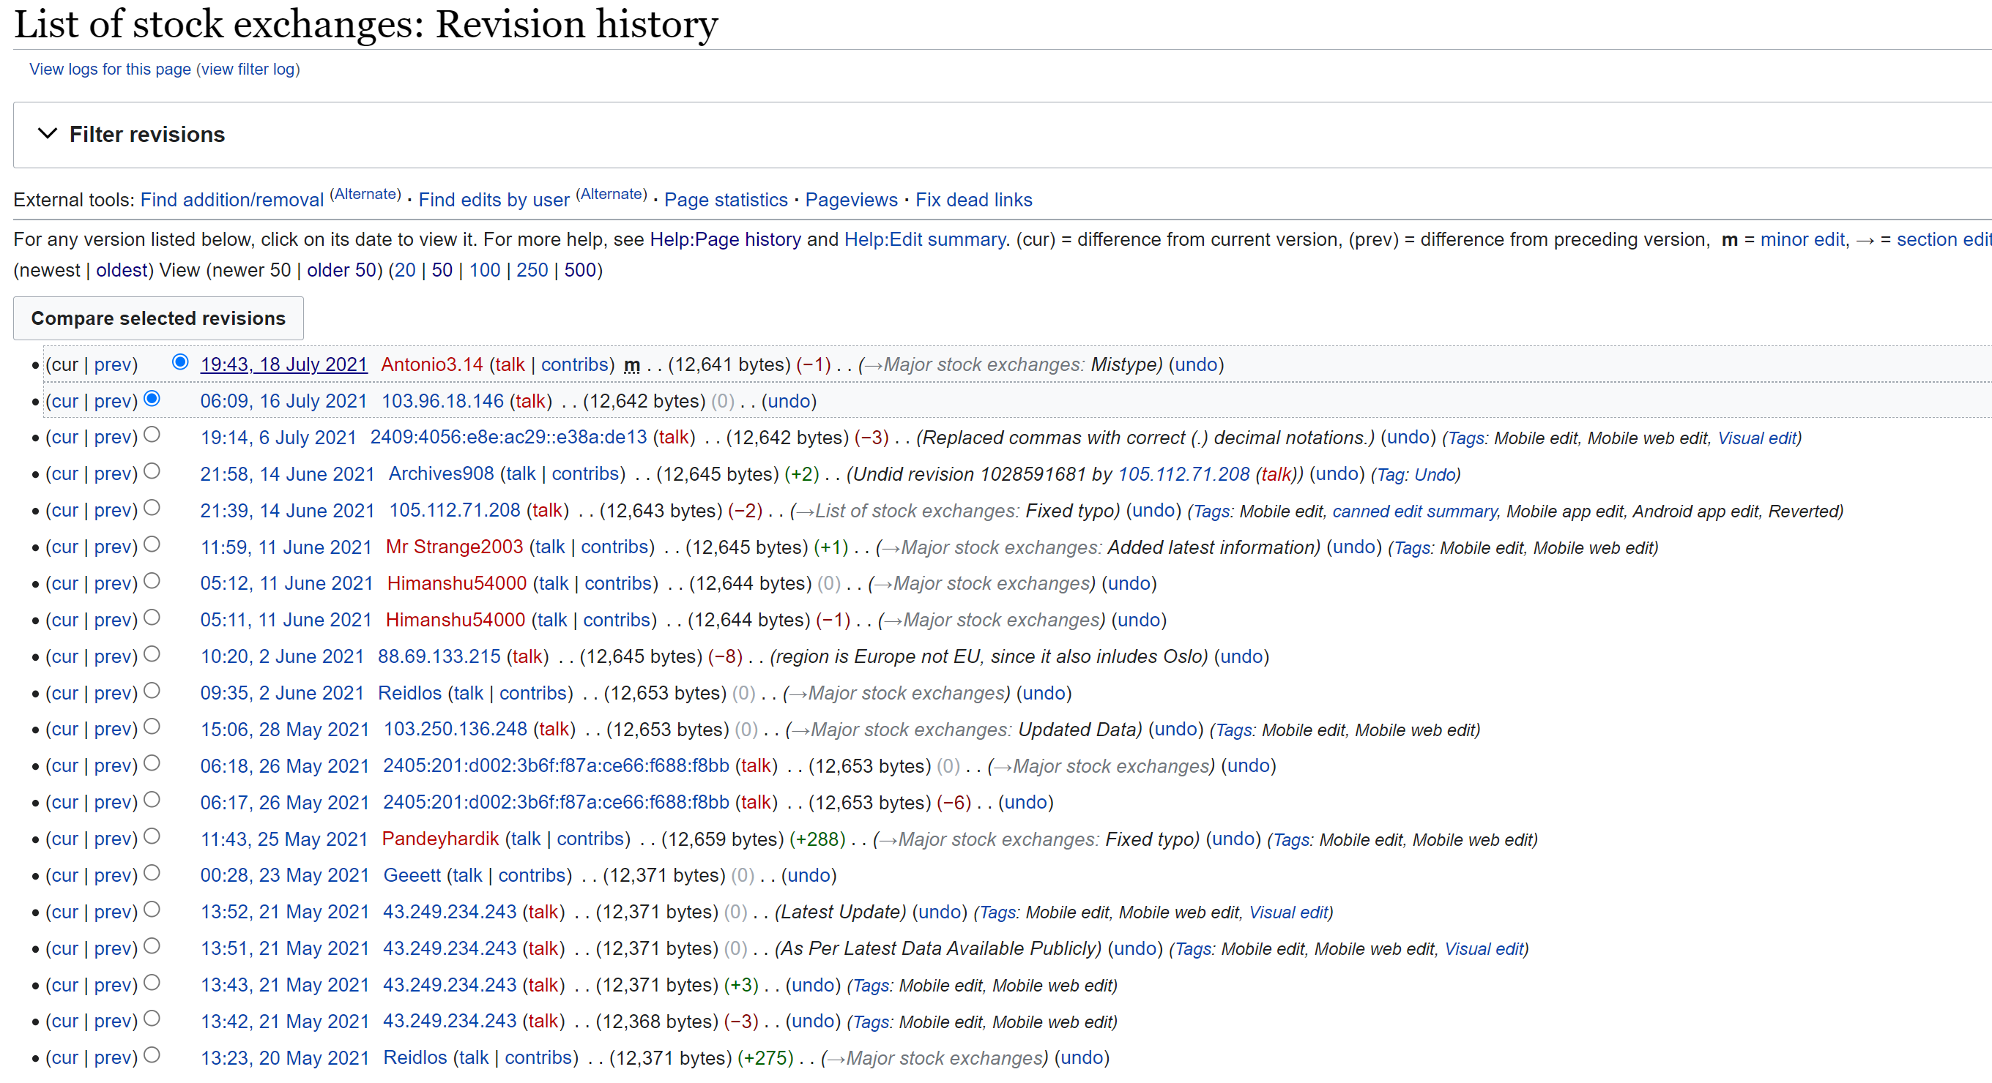

Slide 7
Problems.

Slide 8
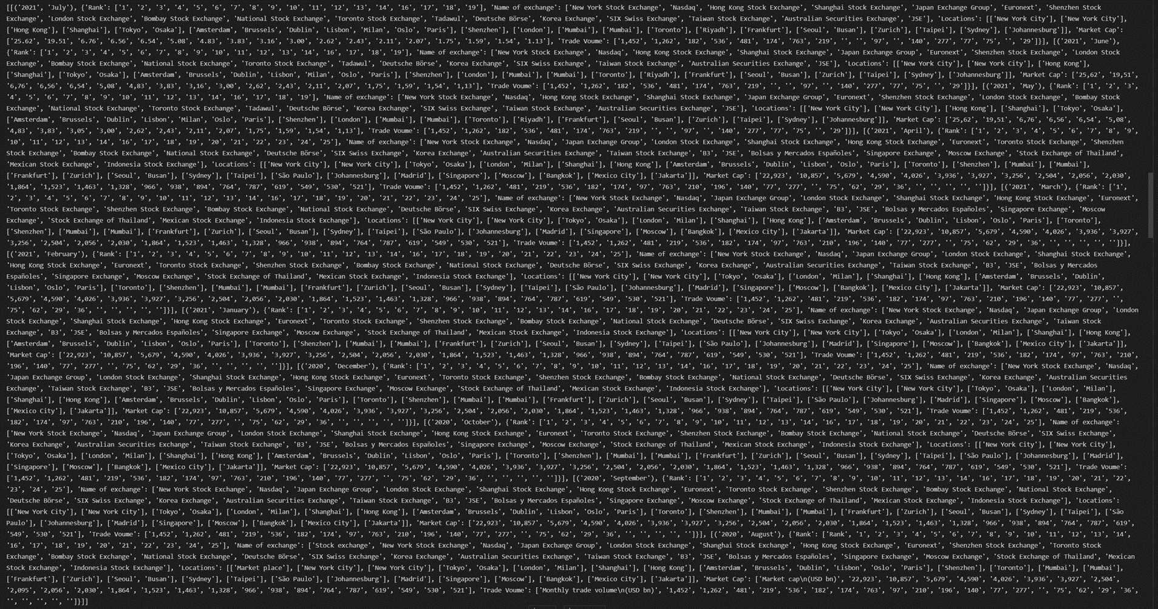

Slide 9
We get some important lists and dictionaries.
List of locations
Month_location_match
These are saved as CSVs.

Slide 10
So we now have a list of locations for each month .
We are going to scrape for the weather in that month at these locations.
But how?

Slide 11

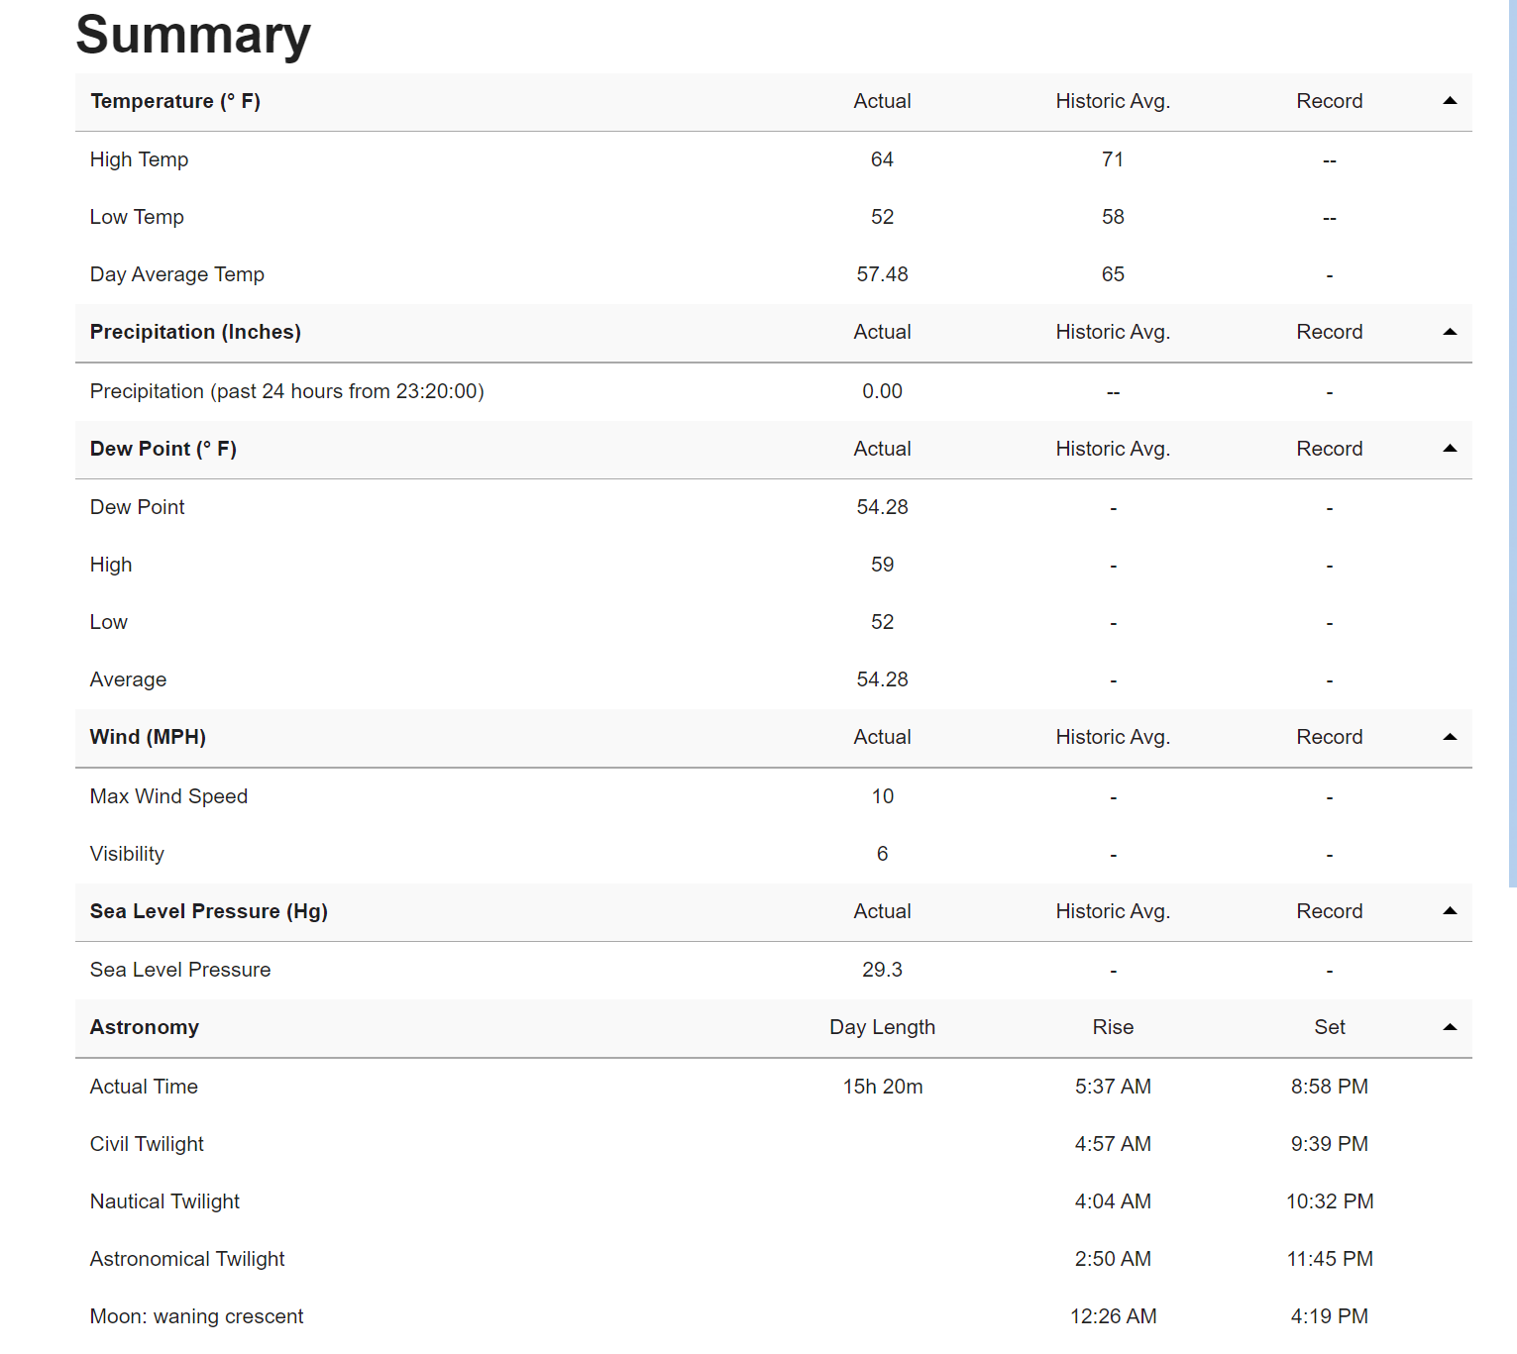
We use this website:

Slide 12
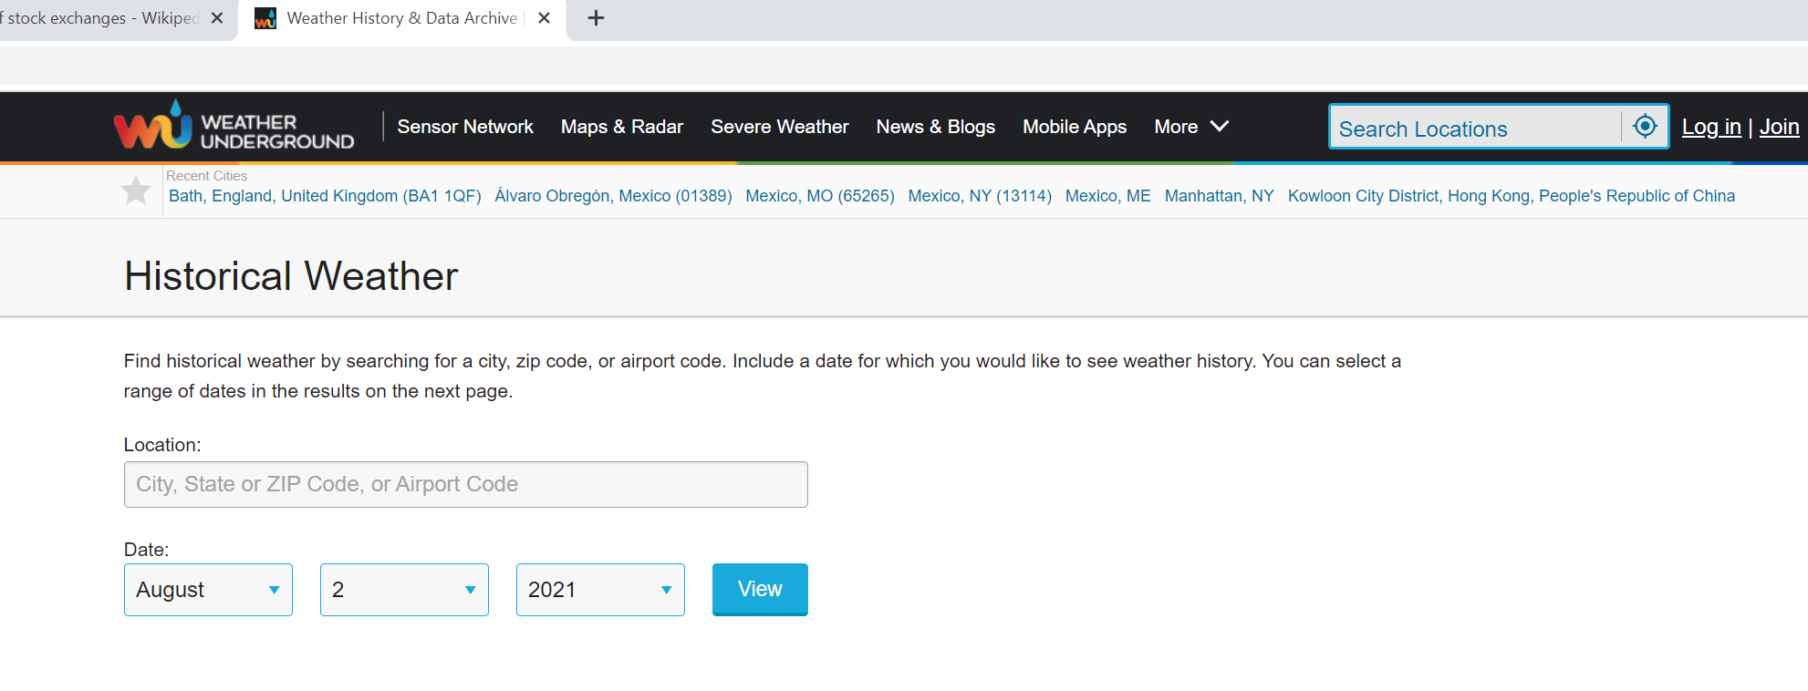

Slide 13
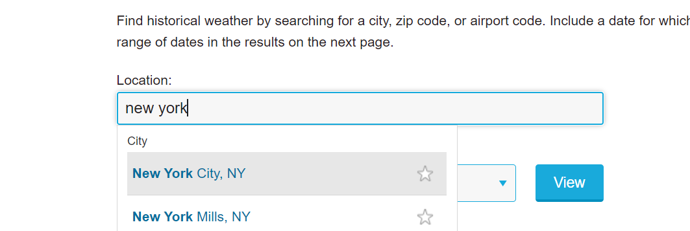

Slide 14
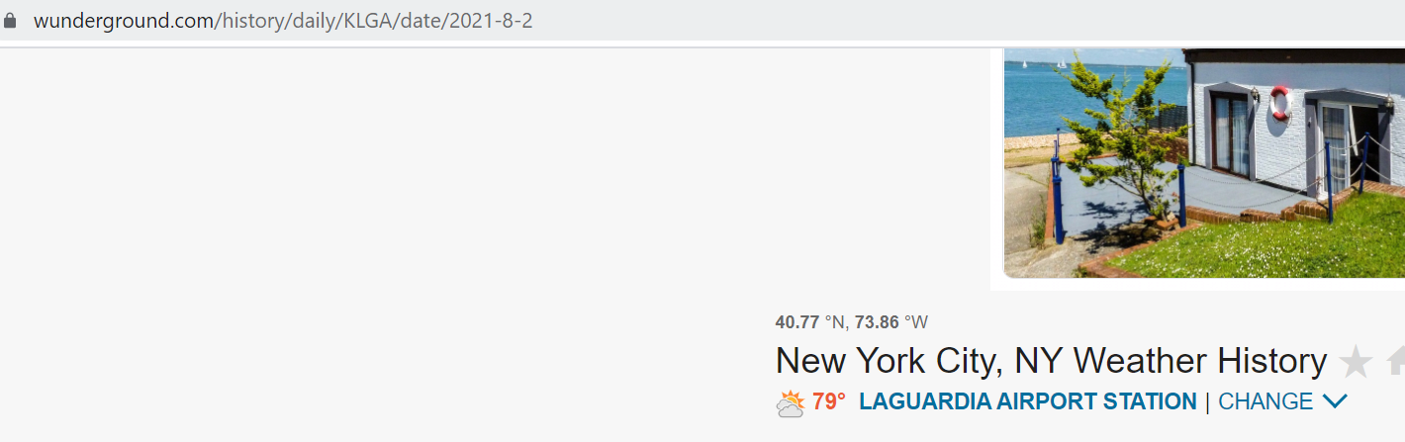
The URL is the key.

Slide 15
This brings us to the next important list.
Location_key_match

Slide 17
Problems:
The data is more uniformly presented so I ran into less problems.

Slide 18
Functions:
trying_scraping()
daily_observations_scraping()

Slide 19
If I were to do the project again…

Slide 20
Questions?

